Slide 1

SYNTHESIS OF 64-BIT ALU USING REVERSIBLE GATES
Presented by
B.TEJASREE
R.SESHU
G.G.C.SRIRAM
K.SAI PRIYANKA
- 14K11A0409
- 15K15A0409
- 14K11A0403
- 14K11A0414
Under the esteemed
Guidance of
Mr. U.Pradeep Kumar
_{M.Tech}
Assistant professor
Department of Electronics and Communication Engineering
PYDAH COLLEGE OF ENGINEERING & TECHNOLOGY

Slide 2
OUTLOOK
ABSTRACT
OBJECTIVE
MOTIVATION
INTRODUCTION
REVERSIBLE GATES
VERILOG
IMPLEMENTED ALU
SIMULATION RESULT
COMPARISON
CONCLUSION

Slide 3
ABSTRACT
An Arithmetic logic Unit (ALU) is used in arithmetic, logical function in all processor.
A 64-bit ALU was designed using Verilog HDL with the logical gates such as AND , OR, XOR for each one bit ALU circuit.
The design was implemented in Xilinx.
Reversible logic vital in recent years because it has ability to reduce the power dissipation which is main requirement in low power design.
Here, we implemented ALU based on reversible logic while comparing it to an ALU architecture with the normal logic gates.
All the modules are synthesized using Xilinx ISE 14.4.

Slide 4
OBJECTIVE
In most of the existing systems, the ALU was designed using irreversible gates.
Our aim is to implement optimized ALU using reversible gates.
This optimized ALU using reversible gates minimizes power dissipation, time delay and area
The main advent of reversible gates is that, we would get ‘n’ number of outputs for ‘n’ number of inputs.

Slide 5
MOTIVATION
Portable consumer electronics is most demanding in every segment of electronic industry and to satisfy the needs of low power electronics, comprehensive approaches and techniques have been proposed by various researchers.
Reversible logic is one among emerging and competent technologies with profound applications in fields of computer graphics, optical information processing, quantum computing, DNA computing, ultra low power CMOS design and communication.

Slide 6
INTRODUCTION
Landauer’s principle states that the amount of dissipated heat is at least kTln2 joules for every bit of lost information,
where k is the Boltzmann’s constant and
T is the absolute temperature
At room temperature, this amount becomes 2.9*10⁻²¹ Joules
In 1973, Bennett showed that KTln2 energy would not dissipate from a system as long as the system allows the reproduction of the inputs from observed outputs.
Information loss in irreversible computation will cause a considerable amount of heat generation in the near future due to increasing density of circuits
Reversible logic is being considered as an alternative of traditional irreversible logic since reversible computing does not erase or lose any information.

Slide 7
REVERSIBLE GATES
The function f(x₁,x₂ … x_{n}) of n Boolean variables is called reversible if:
1. The number of outputs is equal to the number of inputs.
2. Any input pattern maps to a unique output pattern.
The relation between garbage outputs and constant inputs is
input + constant input = output + garbage
n-1
k
.
.
.
.
.
.
n-1
k
Y
Y
k-1
1
0
Reversible circuit
k-1
1
0
.
.
.
.
.
.
f(X)
X

Slide 8
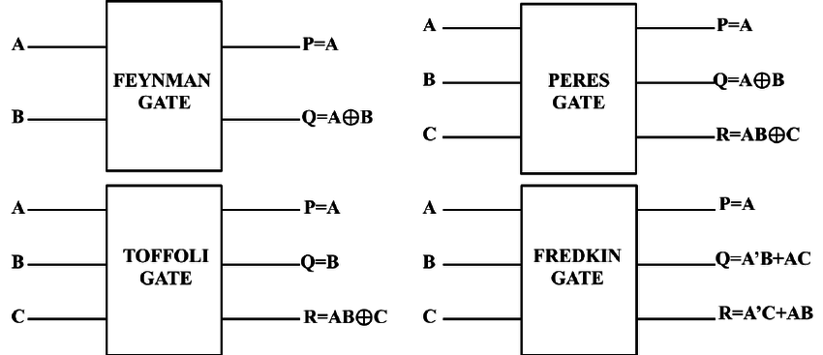
REVERSIBLE GATES
Reversible are circuits (gates) that have one to one mapping between vectors of inputs and outputs

Slide 9
REVERSIBLE GATES
A Reversible logic circuit should have the following salient features:
 Use minimum number of reversible gates.
 Use minimum number of garbage outputs.
Use minimum number constant inputs.
Reversible logic is applicable to the research areas such as
 Low power CMOS design,
 Optical computing,
 Quantum computing,
 Bioinformatics,
 Thermodynamic technology,
 DNA computing and Nanotechnology

Slide 10
VERILOG
Verilog is a hardware description language , most commonly used for designing and verification of digital circuits
A Verilog design consists of a hierarchical of modules
It’s syntax is somewhat similar to C and also case sensitive like C
There are different types of simulators like Aldec, Tachyon, design automation, Cadence design system, Xilinx, Mentor graphics, Frontline…
One can design any circuit using one of the three different abstraction levels 1. Behavioral
2. Dataflow
3. Gate level / Structural

Slide 11
VERILOG
PROGRAM STRUCTURE
TEST MODULE STRUCTURE
module <module name> (< port list >);
< declares >
< module items >
endmodule
module < test module name >;
// Data type declaration
// Instantiate module
// Apply the stimulus
// Display results
endmodule

Slide 12
IMPLEMENTED ALU
Adder
64-bit
ALU
S₀ | S₁ | S₂ | Operations Performed
0 | 0 | 0 | Addition
0 | 0 | 1 | Subtraction
0 | 1 | 0 | Multiplication
0 | 1 | 1 | And
1 | 0 | 0 | Or
1 | 0 | 1 | X-Or
1 | 1 | 0 | Transfer A
1 | 1 | 1 | Transfer B
Subtractor
Multiplier
And
Out
Or
X-Or
Transfer A
Transfer B
s₀
s₁
s₂

Slide 13
IMPLEMENTED ALU
64-bit adder was implemented using 64 HNG reversible gates
Similarly 64-bit Subtractor was implemented by using 64 HNG reversible gates but giving input b as its 2’s complement
A
B
C
D
HN
Gate
(HNG)
A
B
A⊕B ⊕C
(A ⊕B)C ⊕(AB ⊕D)
Haghparast and Navi gate

Slide 14
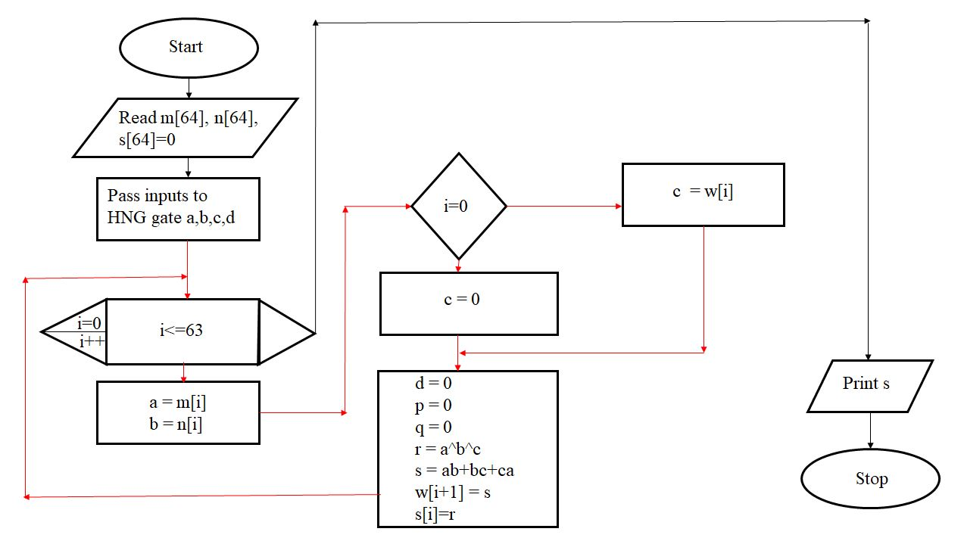
ADDITION

Slide 15
MULTIPLICATION
For multiplication, we used basic 2x2 multiplier using “Urdhva tiryakbhayam multiplication algorithm”
a₀
b₀
PERES GATE
g
g
q₀
0
PERES GATE
q₀ = a₀b₀
q₁ = (a₀b₁) xor (a₁b₀)
q₂ = (a₀a₁b₀b₁) xor (a₁b₁)
q₃ = a₀a₁b₀b₁
g
a₁
b₁
PERES GATE
g
g
0
CNOT GATE
q₃
0
q₂
a₁
b₀
PERES GATE
g
g
a₀
b₁
PERES GATE
g
g
0
q₁

Slide 16
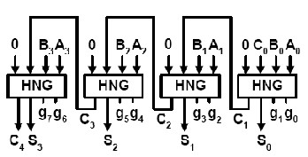
MULTIPLICATION
The Reversible 4X4 Urdhva Tiryakbhayam Multiplier design emanates from the 2X2 multiplier
b[3:2]
a[3:2]
b[3:2]
a[1:0]
b[1:0]
a[3:2]
b[1:0]
a[1:0]
2 X 2 UT MULTIPLIER BLOCK
2 X 2 UT MULTIPLIER BLOCK
2 X 2 UT MULTIPLIER BLOCK
2 X 2 UT MULTIPLIER BLOCK
{q₃[3:0],0,0}
{0, 0, q₂[3:0]}
q₁[3:0]
q₀[3:0]
{0, 0, q₀[3:2]}
6 BIT RIPPLE CARRY ADDER
4 BIT RIPPLE CARRY ADDER
s₁[5:0]
{0,0,s₂[3:0]}
6 BIT RIPPLE CARRY ADDER
Block diagram of 4bit ripple carry adder
Q[1:0]
Q[7:2]
Block diagram of 4x4 UT multiplier

Slide 17
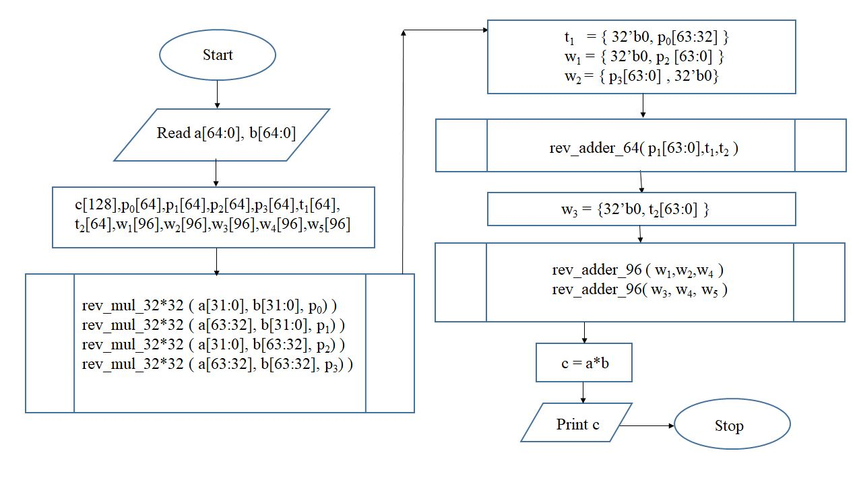
MULTIPLICATION

Slide 18
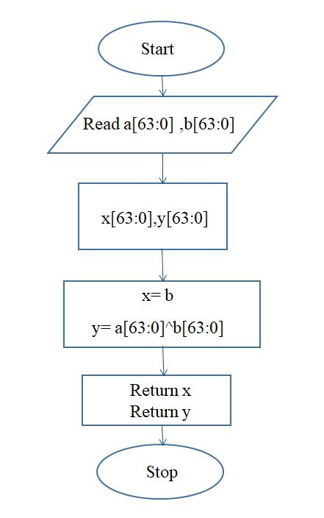
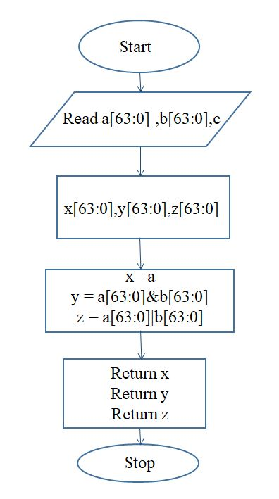
XOR,OR,AND,TRANSFER INPUTS

Slide 19
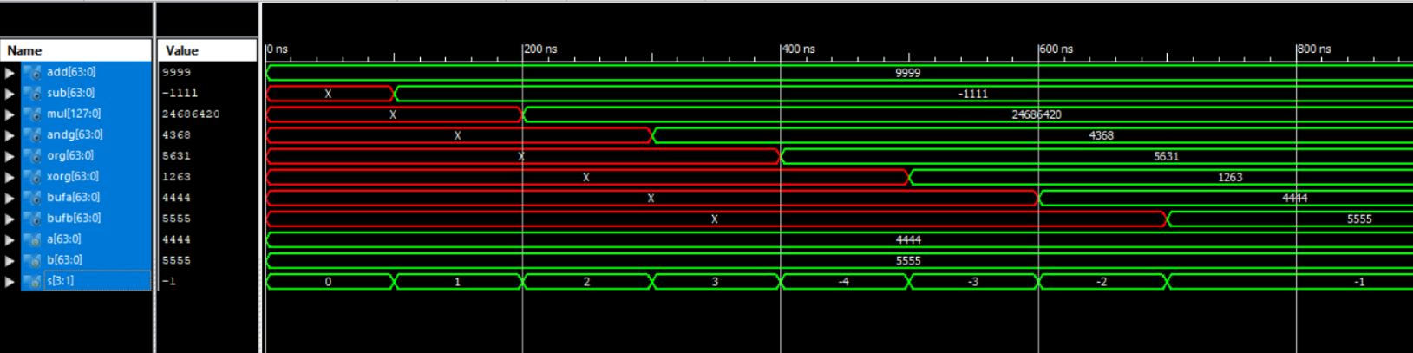
SIMULATION RESULT

Slide 20
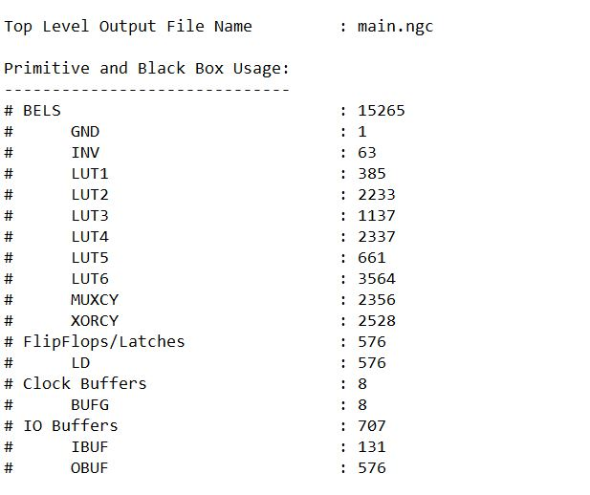
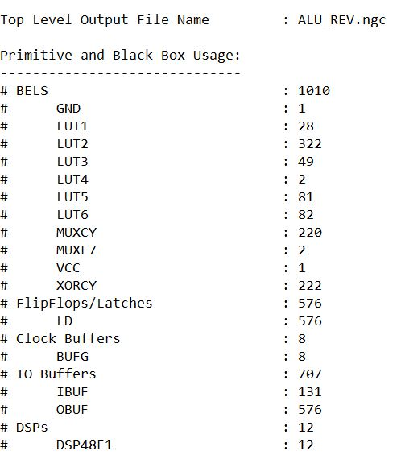
COMPARISON
parameters | 64bit ALU | 64bit reversible ALU
delay | 19.645ns | 12.058ns
No of LUT | 10380 | 564

Slide 21
CONCLUSION
When comparing, irreversible gate logic delay has been decreasing from 19.64ns to 12.058ns
The size of the implementation is also improved.

Slide 22
THANK YOU

